Slide 1

Department of Computer Science & Engineering (DATA SCIENCE)
MINI PROJECT PRESENTATION
AY ODD 2024-25
DISEASE PREDICTION
PRESENTED BY:-
Aditi Jadhav
Ananya Rawool
Anjali Chauhan
Roshni Kane
GUIDED BY:-
Prof. Dhanashri Dhawale
Notes:
1

Slide 2
Contents
1. Introduction
1.1 Motivation
1.2 Problem Statement
1.3 Objectives
2. Literature Survey
3. Proposed Methodology
3.1 Flowcharts
4. Implementation
5. Result and Discussion
5.1 Result
5.2 Discussion
6. Conclusion
6.1 Future Scope
References

Slide 3
1. Introduction
Parkinson's disease (PD) is a neurodegenerative disorder affecting 60% of people over the age of 50 years. Patients with Parkinson's (PWP) face mobility challenges and speech difficulties, making physical visits for treatment and monitoring a hurdle. PD can be treated through early detection, thus enabling patients to lead a normal life. Likewise, Alzheimer's is a dynamic ailment that decimates the mind's memory and its general functioning. The detection of Alzheimer’s can't be wiped out in the first stages within the current scenario. Earlier detection of these diseasea can help in providing the specified treatment to stop it happening anytime sooner as there's no cure for these diseases. Disease prediction involves using data to foresee the likelihood of someone getting a disease. This helps doctors identify high-risk individuals early, so they can provide personalized treatment and ultimately enhance the quality of care.

Slide 4
1.1 Motivation
This project focuses on predicting neurodegenerative diseases like Parkinson's and Alzheimer's, which significantly impact individuals and healthcare systems. With their growing prevalence, early detection becomes crucial for timely intervention. By leveraging predictive analytics, we aim to empower patients and families with informed decisions, leading to better health management and improved emotional well-being. Our goal is to enhance early detection, optimize care strategies, and contribute to a healthier future for those at risk of these debilitating diseases.

Slide 5
1.2 Problem Statement
Many diseases are often diagnosed at a late stage when they are harder to treat and manage. Late diagnosis leads to lower treatment success rates and higher mortality rates. Treating advanced stages of diseases requires more resources, longer hospital stays, and more expensive procedures. This increases the overall cost of healthcare, making it less affordable for patients and healthcare providers. Late-stage diseases need more resources, longer hospital stays, and more expensive treatments, which can be avoided with early detection. By predicting diseases before they fully develop, doctors can provide better care and reduce costs.

Slide 6
1.3 Objectives
Disease prediction focuses on improving healthcare outcomes and resource management. Key objectives include early detection for timely intervention and better patient outcomes. Risk assessment helps tailor personalized medicine and preventive strategies. It also aids in managing high-risk populations to improve public health. Predicting disease trends enables efficient resource allocation and reduces hospitalizations. Overall, it optimizes healthcare delivery and enhances the care quality.

Slide 7
2. Literature Survey
Publication | Title of the Paper | Publication Year | Authors | Summary
Materials today Proceedings | Alzheimer's disease prediction using machine learning techniques and principal component analysis (PCA) | 2023 | M.Sudharshan & G.Thailambal | Several machine learning algorithms are used for the early detection of Alzheimer's disease. IVM: A variant of SVM that selects a subset of training data for efficiency.- RELM: An extension of ELM with regularization to improve accuracy and control overfitting.
MDPI | Improved Alzheimer’s Disease Detection by MRI Using Multimodal Machine Learning Algorithms | 2021 | Gopi Battineni, Mohmmad Amran Hossain, Nalini Chintalapudi,Enea Traini,Venkata Rao Dhulipalla, Mariappan Ramasamy and Francesco Amenta | Gradient Boosting: 87.58% accuracy – An ensemble method that builds models sequentially to correct previous errors, achieving the highest accuracy. Support Vector Machines (SVM): 90.27 % accuracy – A classifier that finds the optimal hyperplane to separate different classes in high-dimensional spaces. Logistic Regression (LR): 86.78% accuracy – A straight forward model that predicts binary outcomes using a logistic function.

Slide 8
Publication | Title of the Paper | Publication Year | Authors | Summary
Procedia Computer Science | Early detection of Parkinson’s disease using machine learning | 2023 | Elsewhere B.V | This study evaluates machine learning algorithms for early Parkinson's disease detection using MDVP audio data. Among the models tested—Support Vector Machine, Random Forest, K-Nearest Neighbors, and Logistic Regression—the Random Forest classifier achieved the highest accuracy of 81.83% and a sensitivity of 0.95.
Materialstoday Proceedings | Detection and analysis of Alzheimer’s disease using various machine learning algorithms | 2021 | P. Kishore a, Ch. Usha Kumari b, M.N.V.S.S. Kumar c, T. Pavan | This model can process the MRI images for better analysis and research to produce good outcomes. •Sophisticated results which provide useful insights for a particular patient details. •Can be extended to a recommendation engine for a better treatment, which replaces the doctors work Accuracy of 85.89%

Slide 9
3. Proposed System
Data Collection: Gather data such as MDVP, Shimmer, HNR, DFA, etc.
Data Pre-processing: Clean the data, handle missing values, and encode categorical variables.
Feature Engineering: selecting the most relevant features (variables) from the dataset that are likely to be predictive of the disease. Demographic Details, Lifestyle Factors, Medical History, Clinical Measurements, Cognitive and Functional Assessments and Symptoms.
Model Selection: Choose appropriate machine learning models for prediction such as support vector machine and logistic regression model.
Model Training: Train the selected model using labeled data or patterns in data. This involves splitting the dataset into training and testing sets to evaluate the model's performance.
6. Model Evaluation: Assess the model's performance using metrics like accuracy, precision, recall, and F1-score. Also, consider using techniques like ROC curve analysis.
7. Monitoring and Maintenance:Deploy the trained model into clinical practice or public health settings to assist in disease prediction. Continuously monitor the model's performance and update it as new data becomes available or as the disease landscape changes

Slide 10
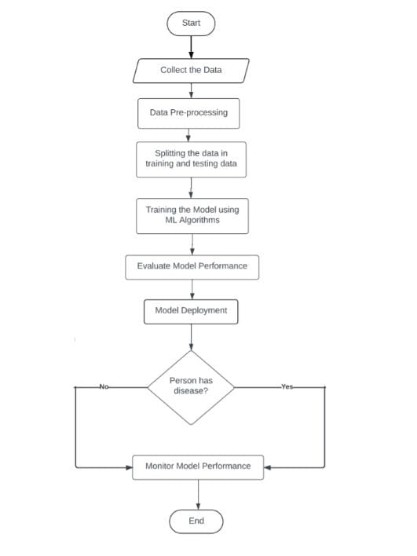
3.1 Flowchart

Slide 11
4. Implementation
Hardware/Tools Used:
Computer – Lenovo
Processor – 11th Gen Intel(R) Core(TM) i5-11300H @ 3.10 GHz 2.61 GHz
RAM - 8 GB
Memory Space – 256 GB
Software/Technologies Used:
Google Collab
Syder (Anaconda) for GUI
Random Forest Classifier
Sklearn

Slide 12
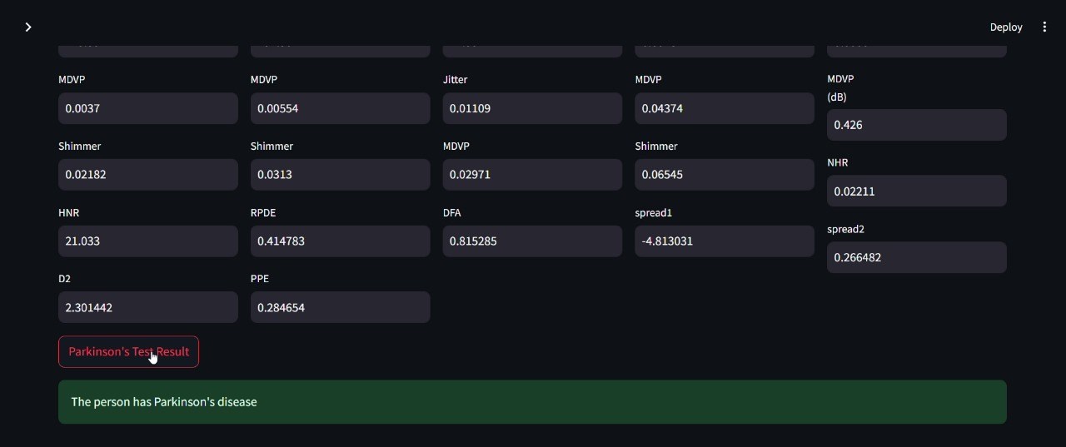
5. Result and Discussion
5.1 Result
Fig. 5.1

Slide 13
5.2 Discussion
As shown in Fig. 5.1, in this model we are collecting the data such as MDVP, DFA, PPE, RPDE and more. These data is use for identifying critical risk factors and early symptoms, the findings contribute to the ongoing efforts to improve early diagnosis and intervention strategies, ultimately aiming to enhance patient care and quality of life.
By applying above two machine learning models and by calculating confusion matrix we got the accuracy of 87 percent and by using these algorithm we get the result as user can detect parkinson disease or not.

Slide 14
6. Conclusion
In this project, we've built models to predict diseases based on user data. The Parkinson's model uses brain MRI measurements while the Alzheimer model uses parameters like BMI, cholesterol, diastolic BP. Each model predicts whether a person has the particular disease or not. Each model provides rapid, accurate predictions, enabling early detection and intervention. This technology offers critical insights for improving health outcomes and managing conditions more effectively.

Slide 15
6.1 Future Scope
Develop more complex machine learning algorithms to improve the efficiency of disease prediction. Implement regular calibration of learning models post-training to potentially enhance performance. Expand datasets across diverse demographics to avoid overfitting and increase model accuracy. Utilize advanced feature selection methods to further boost the performance of learning models.

Slide 16
References
P. Kishore ª, Ch. Usha Kumari ^{b}, M.N.V.S.S. Kumar ^{c}, T. Pavani ^{c} (2021). Detection and analysis of Alzheimer’s disease using various machine learning algorithms, “ materialstoday Proceedings”
Link: https://www.sciencedirect.com/science/article/abs/pii/S2214785320357709
2. Aditi Govindu ª, Sushila Palwe (2023). Early detection of Parkinson's disease using machine learning. Elsevier.
Link: https://www.sciencedirect.com/science/article/pii/S1877050923000078

Slide 17
Thank You

